Slide 1
Executive Presentation: Optimizing Operations for Big Mountain Resort
A Data-Driven Approach to Increasing Profitability Presenter: Shre Kapoor Date: 7/5/2024

Slide 2
Problem Identification
Current State:
Big Mountain Resort charges $81.00 per ticket.
Multiple chairlifts in operation with associated maintenance costs.
Objective:
Increase profitability by optimizing ticket pricing.
Assess and optimize chairlift operations.

Slide 3
Problem Identification (Continued)
Seasonal fluctuations in visitor numbers impacting revenue.
High operational costs from maintaining multiple chairlifts.
Balancing ticket pricing to remain competitive while maximizing revenue

Slide 4
Recommendations and Key Findings
Increase Ticket Price:
Current price: $81.00
Recommended price: $91.23
Justification: Model predicts increased revenue with minimal impact on visitor numbers.
Optimize Chairlift Operations:
Remove one chairlift to reduce costs.
Invest in a new chairlift for future growth.

Slide 5
Model Performance Comparison
Machine Learning Models Used:
Linear Regression
Random Forest (Best performer)– using GridSearchCV for hyperparameters
Evaluation Metrics:
R^2
MSE/MAE

Slide 6
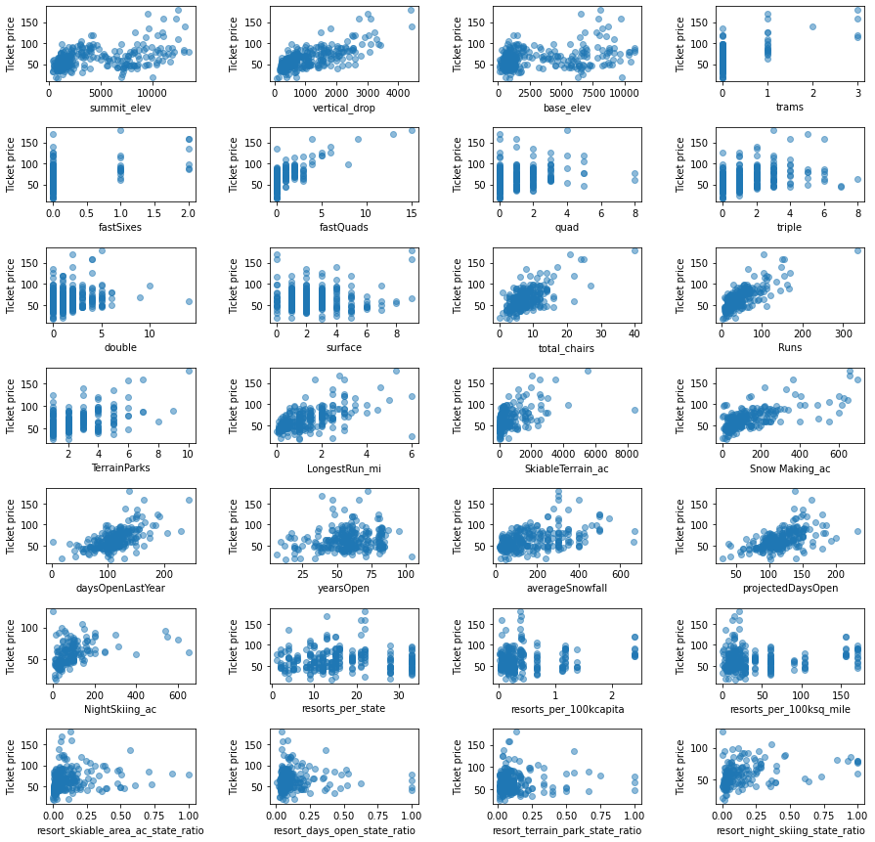
Feature Correlation Plot

Slide 7
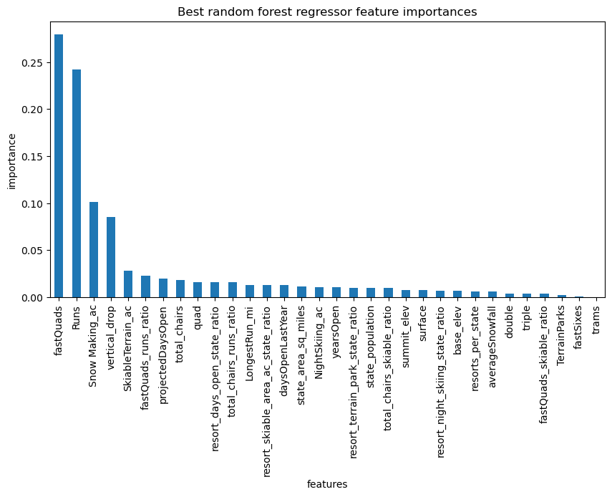
Feature Importance Plot

Slide 8
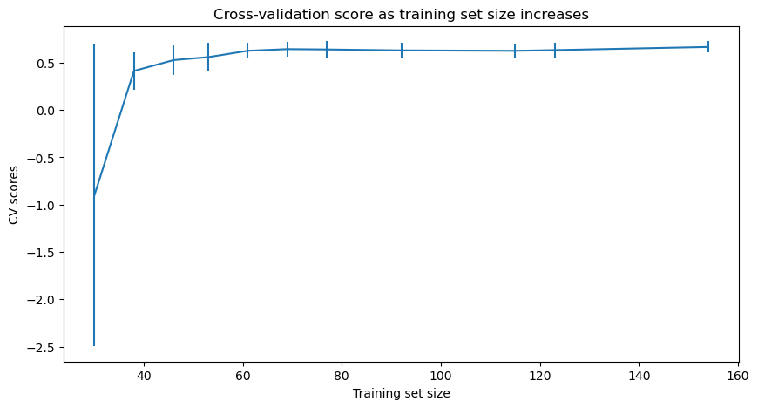
Cross Validation Scores

Slide 9
Scenario Analysis
Impact of Ticket Price Increase:
Predicted revenue growth.
Analysis of visitor sensitivity to price changes.
Effect of Removing One Chairlift:
Cost savings.
Minimal impact on customer experience and satisfaction.
Investing in a New Chairlift:
Long-term profitability.
Increased capacity and enhanced customer experience.

Slide 10
Summary and Conclusion
Summary:
Increase ticket prices to $91.23.
Optimize chairlift operations by removing one and investing in a new one.
Continuous monitoring and updating of models.
Next Steps:
Implement pricing changes.
Reassess chairlift operations and investment strategies.
Future work: Incorporate weekday pricing, detailed cost analyses.

